Slide 1

BMI-520 Final Project
Erik Holmlin, PhD, CEO of Bionano Genomics commented: “ASD is typically diagnosed based on a child’s behavior, and only 3% of children with an ASD diagnosis get clinical genetic testing, which is recommended by a number of professional medical organizations including the American College of Medical Genetics and Genomics and the American Academy of Pediatrics. Widespread adoption of genetic testing is important to patients and families because it creates a better understanding of ASD, but more importantly, informs families and patients about immediate health risks associated with ASD that could personalize treatment options and provide potentially life-saving information.
Autism 1 in 54 children – Can Genomics Offer Relief
Eileen Keck

Slide 2
Genome Sequencing Analysis of Individuals with autism can locate genes which indicate comorbidities. This can be used to identify potential health risks, determine effective personalized treatment plans and offer a better understanding of the causes and treatment options for autism
HYPOTHESIS

Slide 3
It’s all about the data:
The largest, most comprehensive genomic analysis/database of autism spectrum disorder (ASD) conducted to date
BMC Genomics
Related article and data regarding known comorbidities associated with autism and associated genes
Panther
Entered gene set – returns related diseases
GSEA
Download of Gene Kegg Pathways
BMI 520 – Eileen Keck

Slide 4
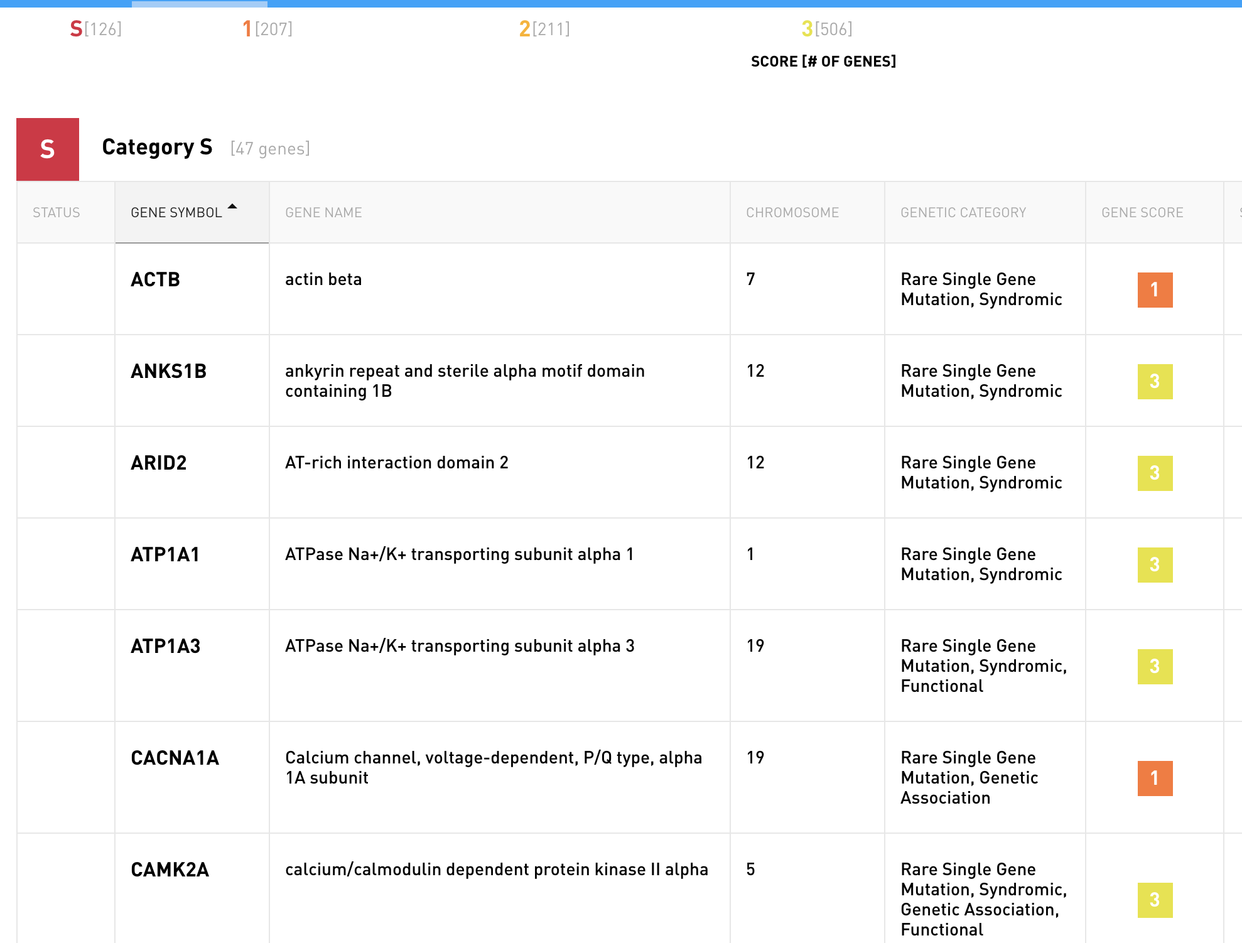

Slide 5
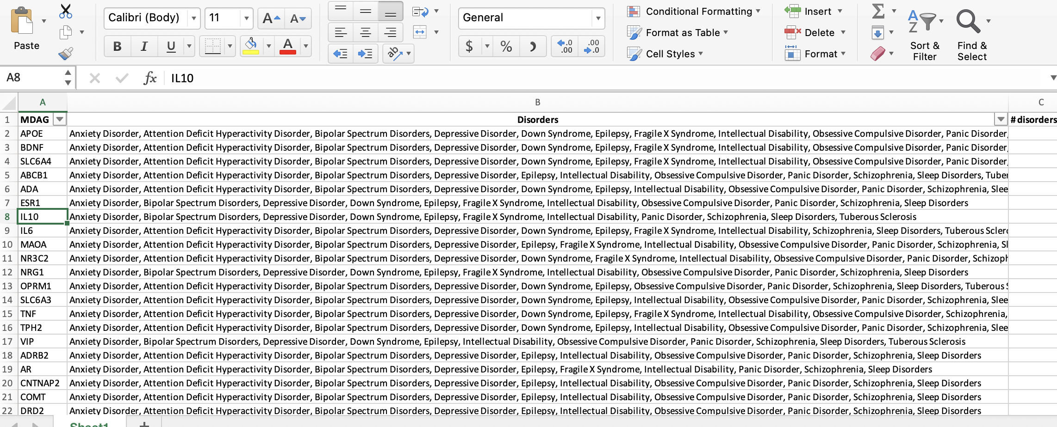
Autism Genes and Comorbid Disorders
Data from three sources:
1. Simons Simplex Collection (SSC), is a permanent repository of DNA samples from nearly 3,000 families
2. Published CNV (copy number variants - deletions or duplications of chunks of the genome), data from the Autism Genome Project, ASD samples from approximately 50 academic and research institutions funded by Autism Speaks and the National Institutes of Health.
3. Data from Autism Sequencing Consortium (ASC), an initiative supported by the National Institute of Mental Health

Slide 6

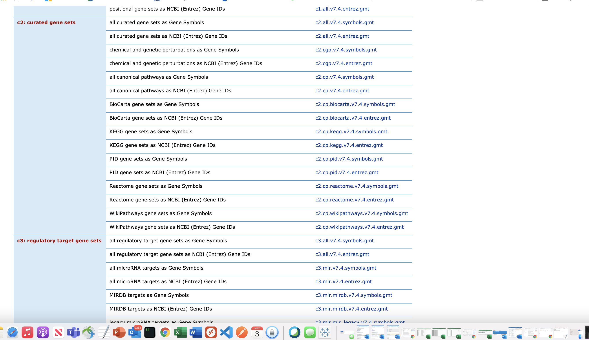
YES SHE FOUND THE PATHWAYS!!!!!!!
Pathways - Kegg

Slide 7
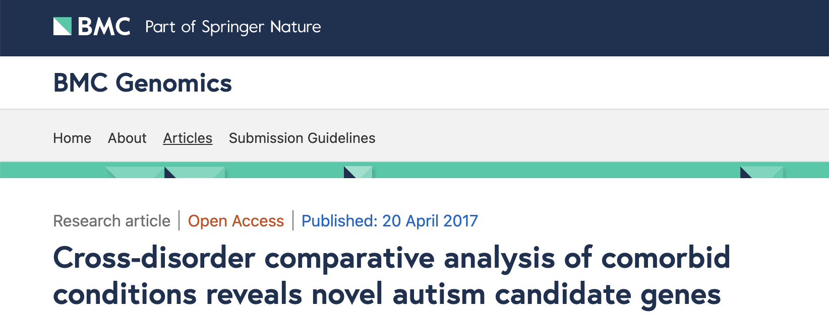
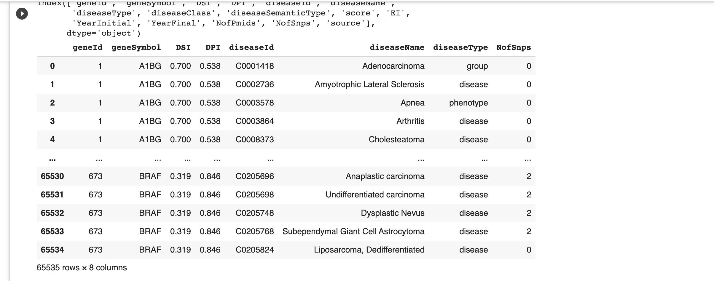
Removed unrelated Columns

Slide 8

Becoming One with the DATA

Slide 9
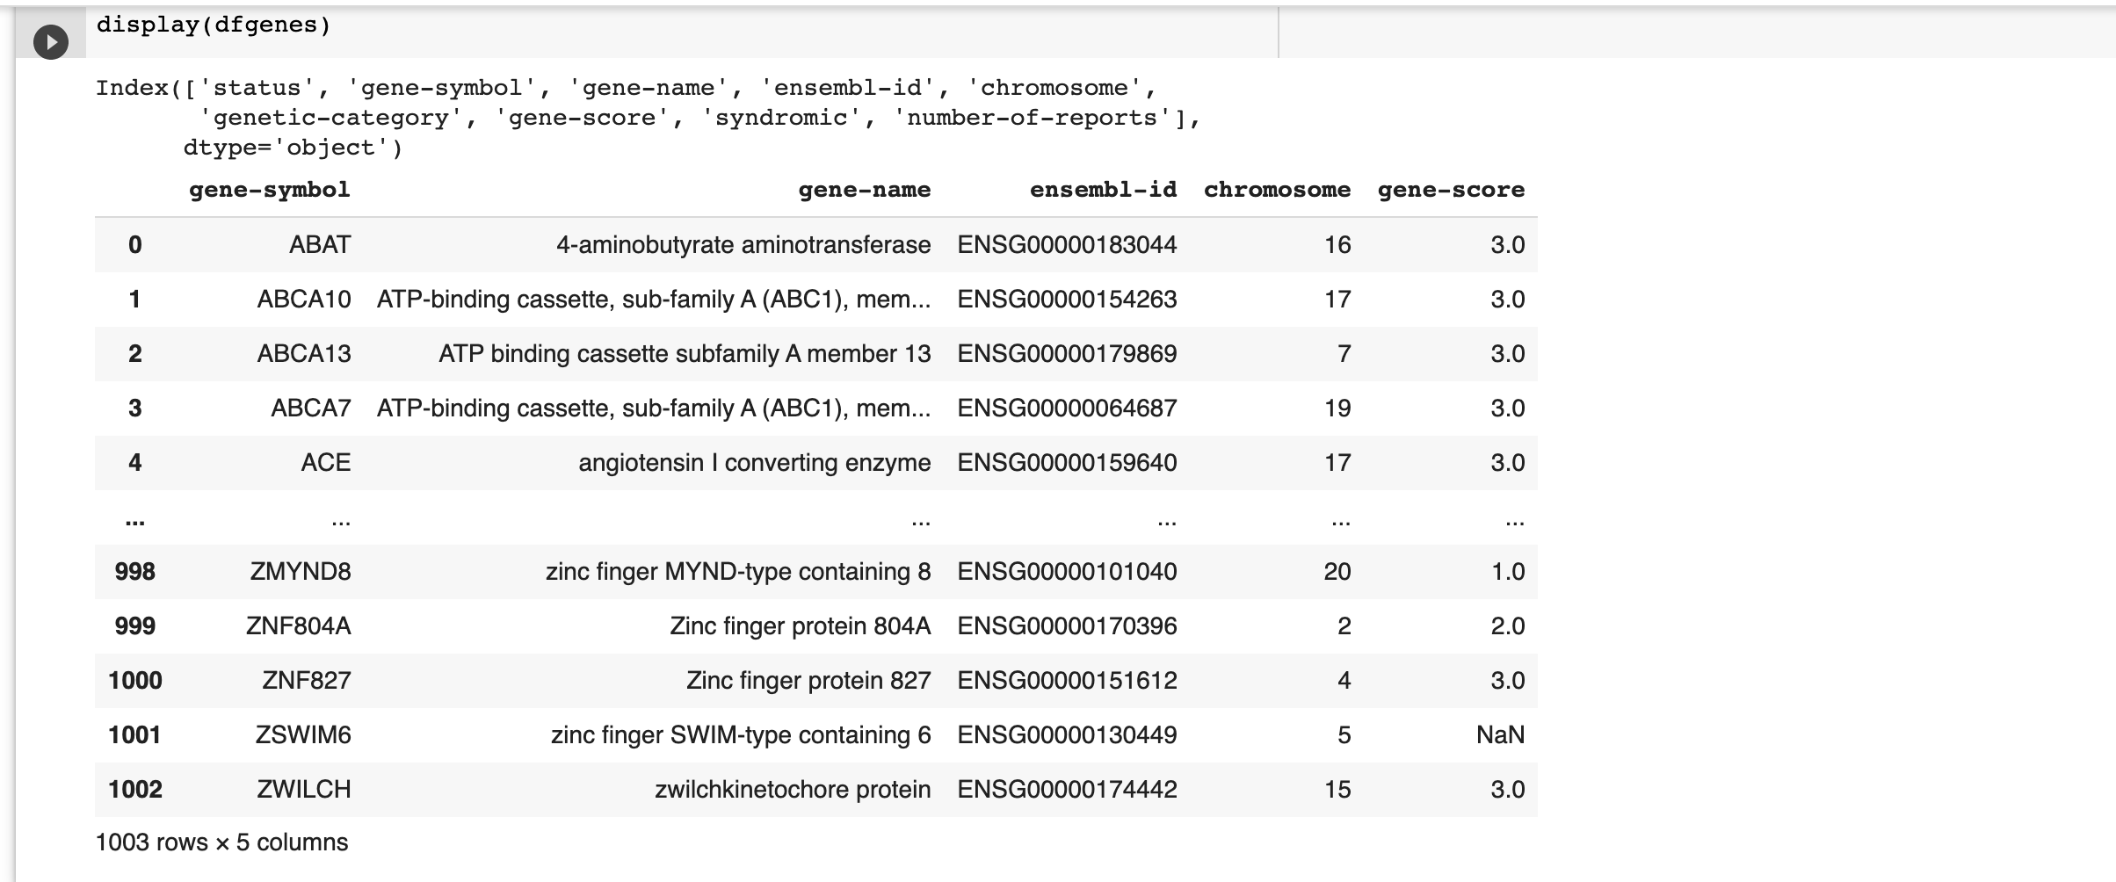
SFARI – Provides Gene-Scores (Scores 1 & 2 autism related)

Slide 10
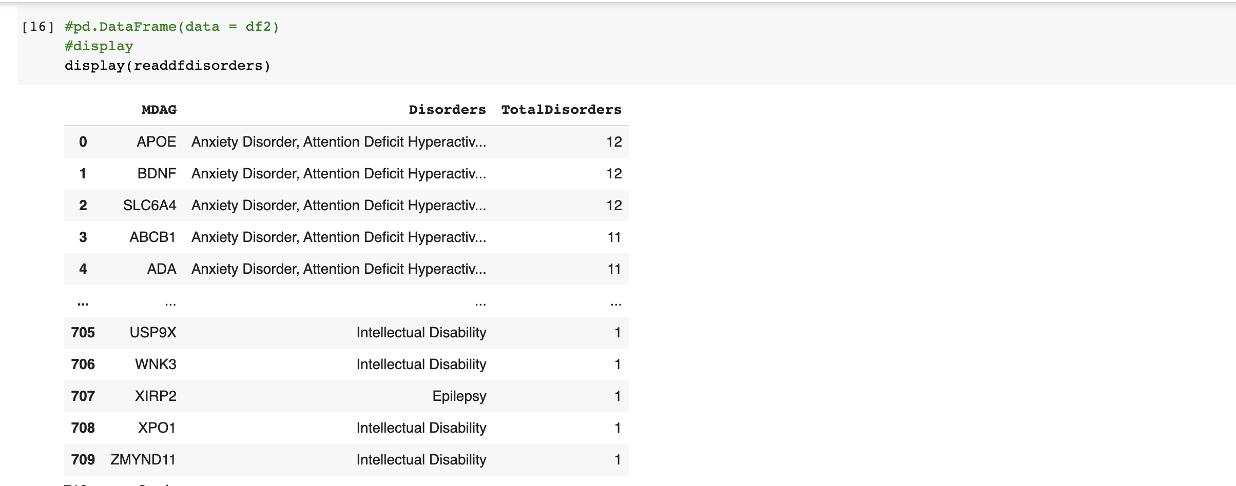
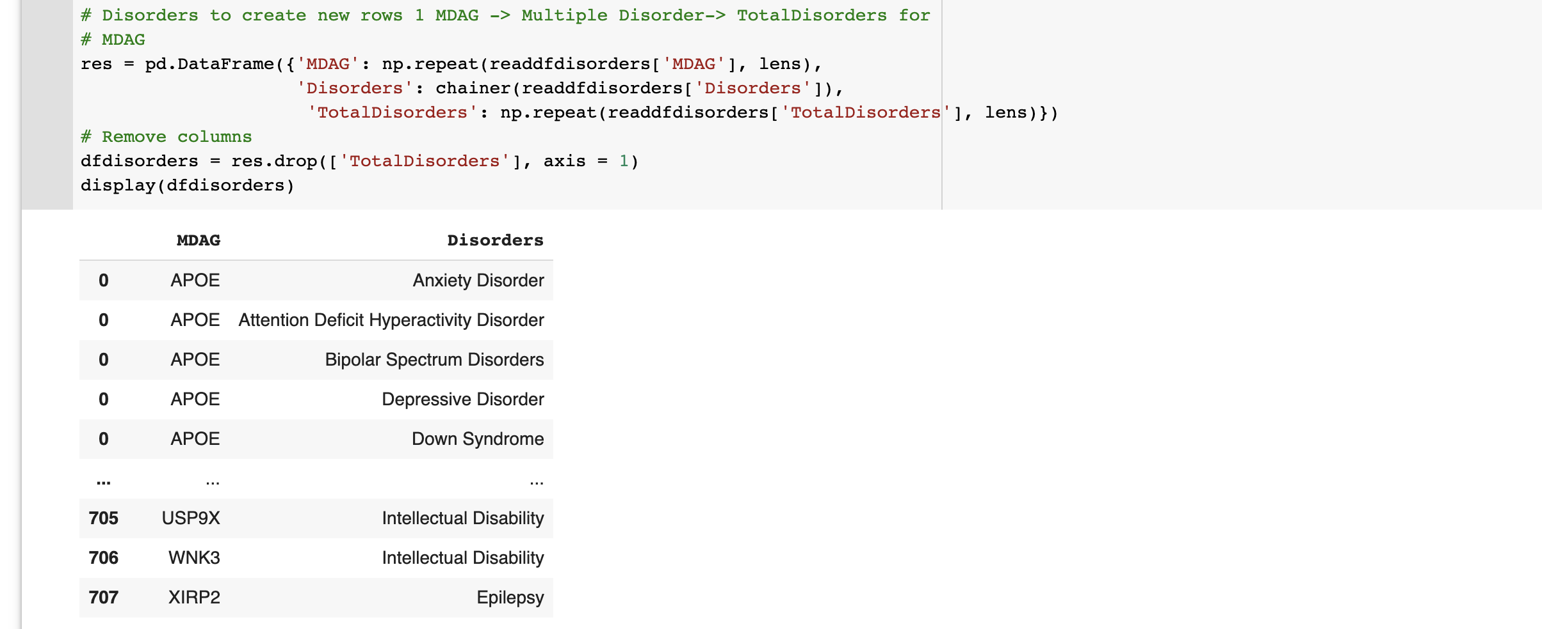
Disorders manipulate data to gene, disorder for each disorder and order by Disorder

Slide 11
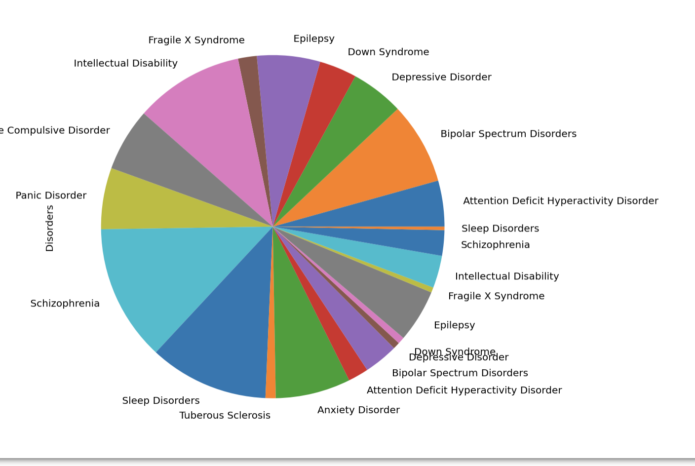
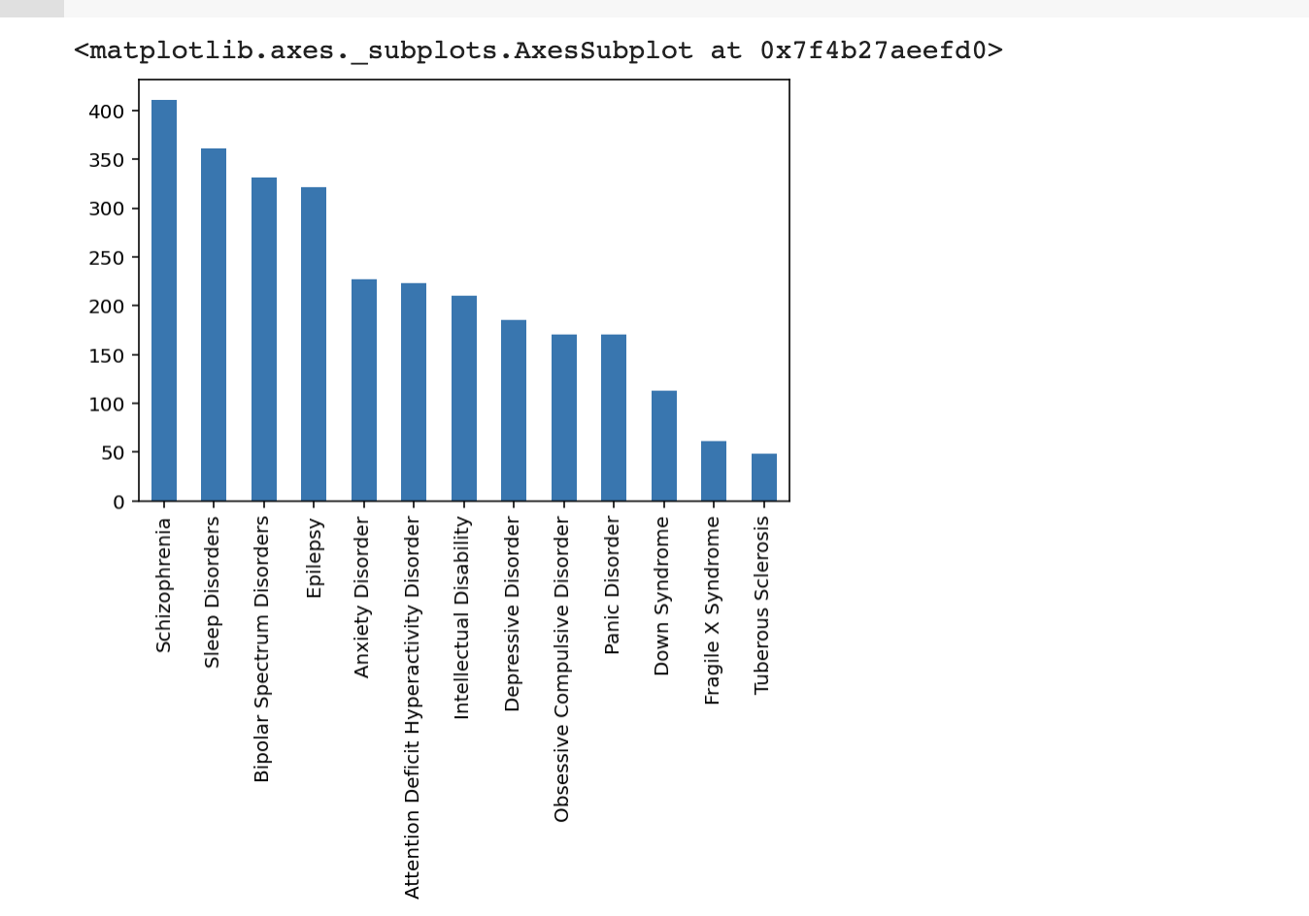
Disorders manipulate data to gene, disorder for each disorder and order by Disorder

Slide 12
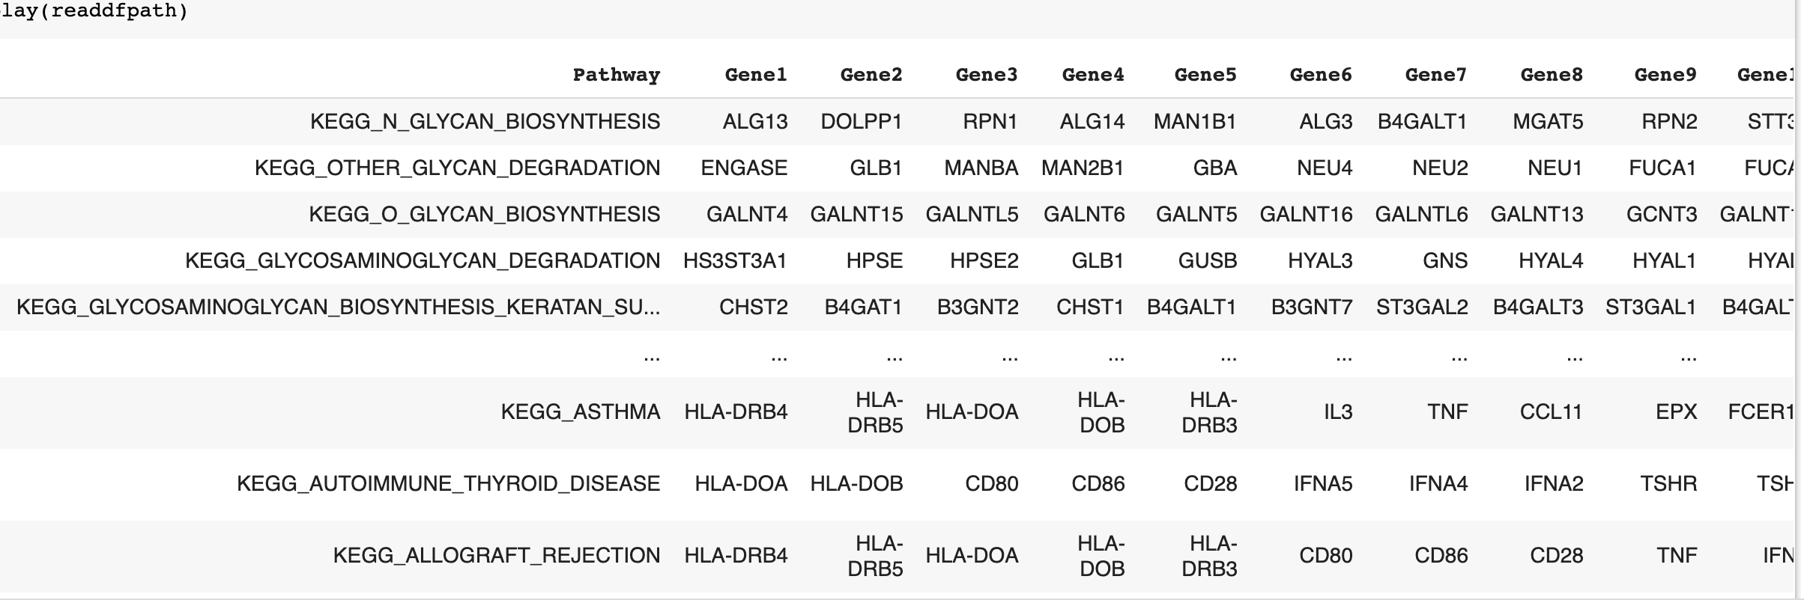
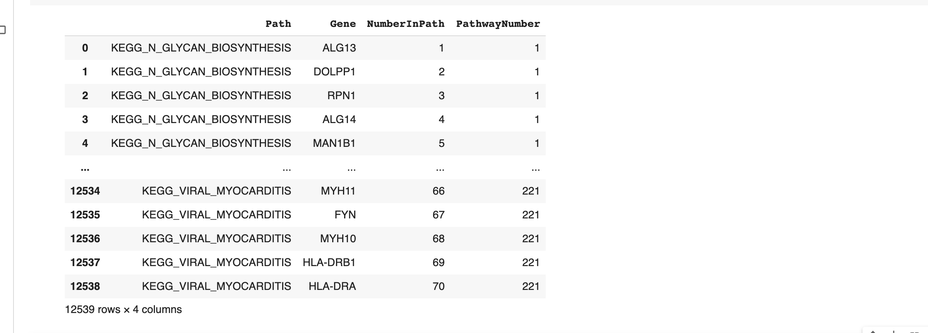
GSEA - Pathway Provides Kegg Human Genome Dataset Again manipulated data to Pathway,Gene, one per row Added Pathway Number and Number in Path final < 20 Number in Path

Slide 13
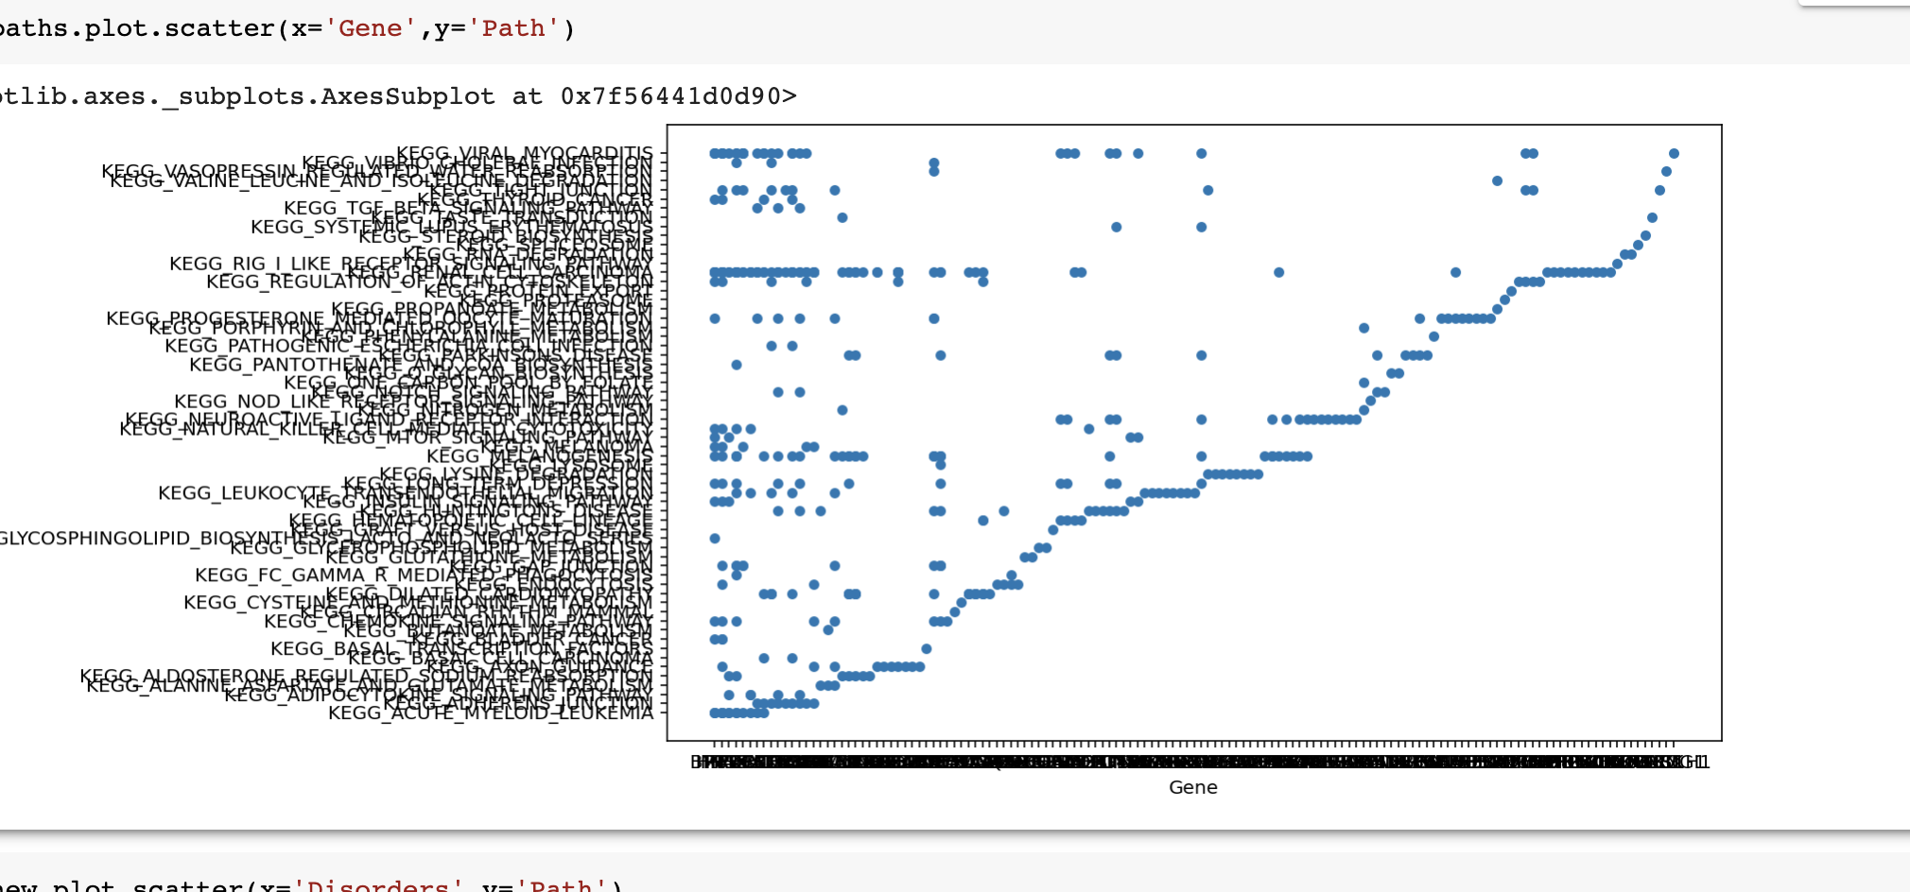
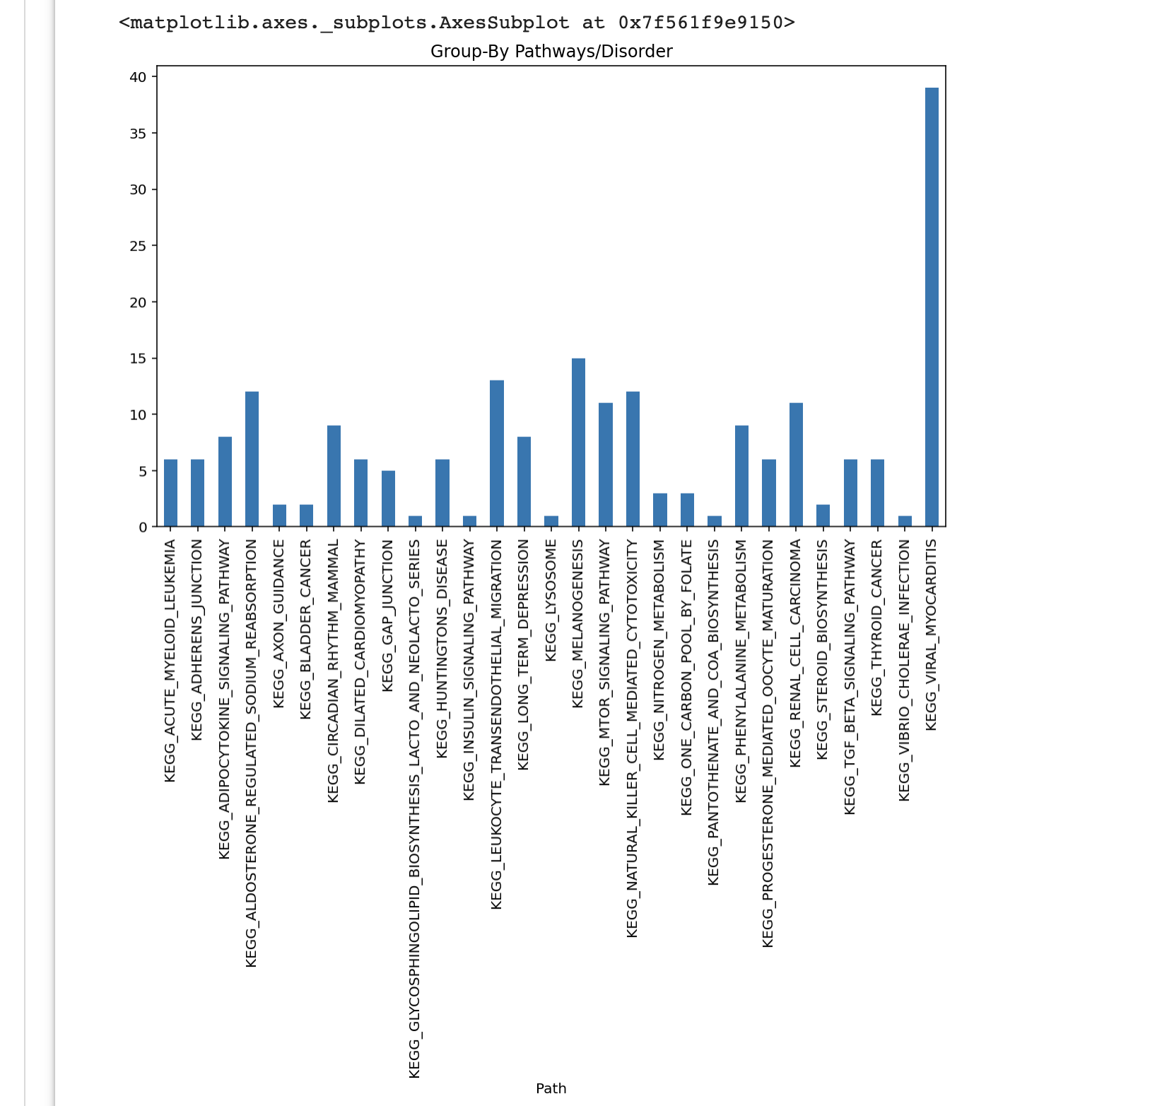
GSEA - Pathway Provides Kegg Human Genome Dataset Added counts of Pathway and found positive correlation to genes as expected
Remove Pathway genes that are > 20 in the pathway – Plot Pathway/Disorders

Slide 14
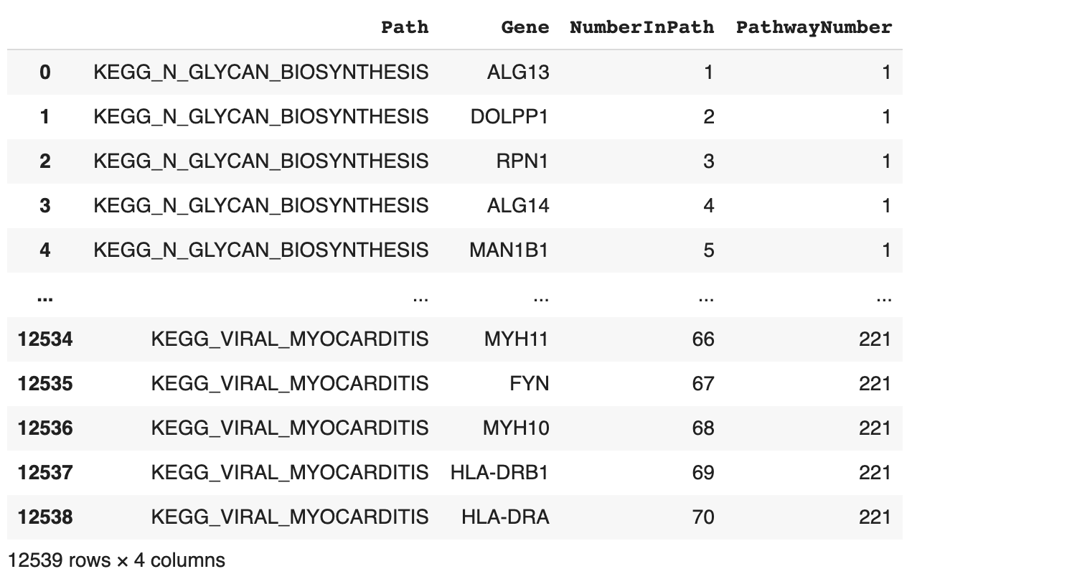
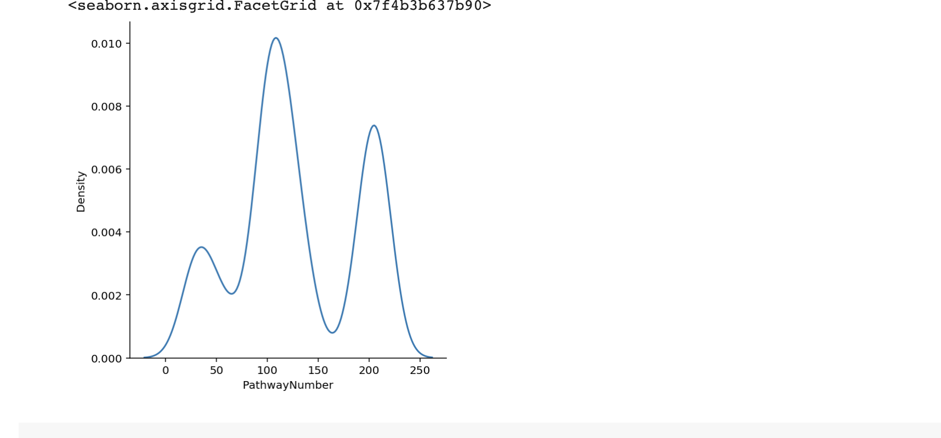
GSEA - Pathway Provides Kegg Human Genome Dataset Added counts of Pathway and found positive correlation to genes as expected
Remove Pathway genes that are > 20 in the pathway – Plot Pathway/Disorders

Slide 15

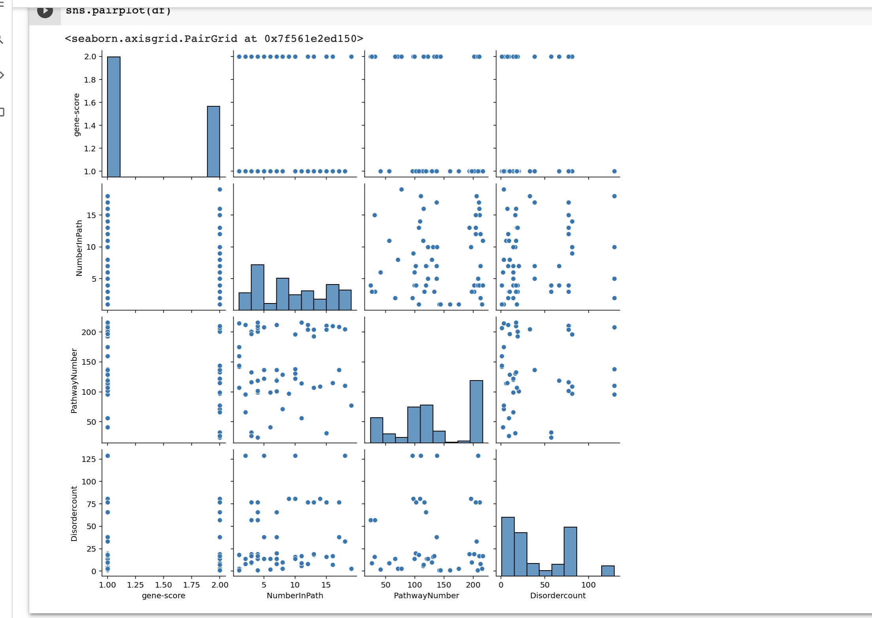
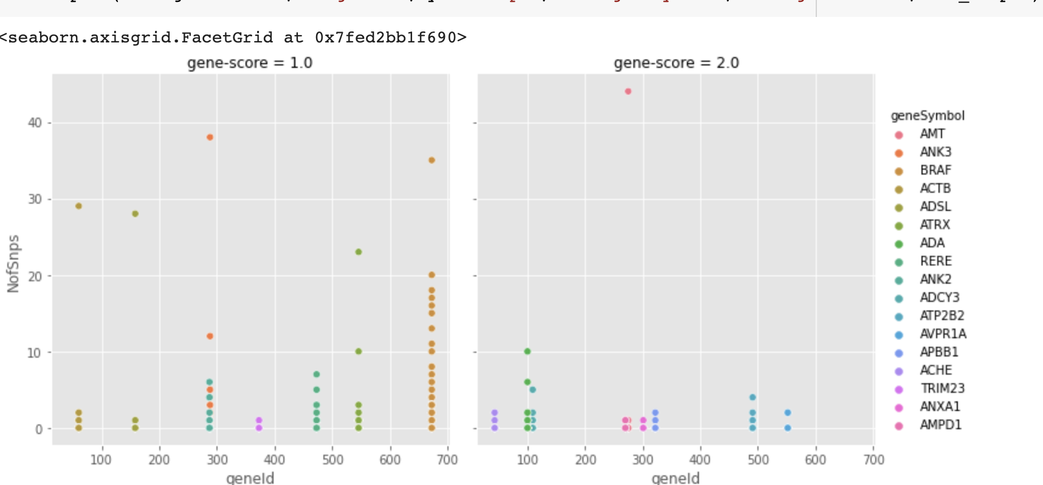
Data Tells a Story

Slide 16

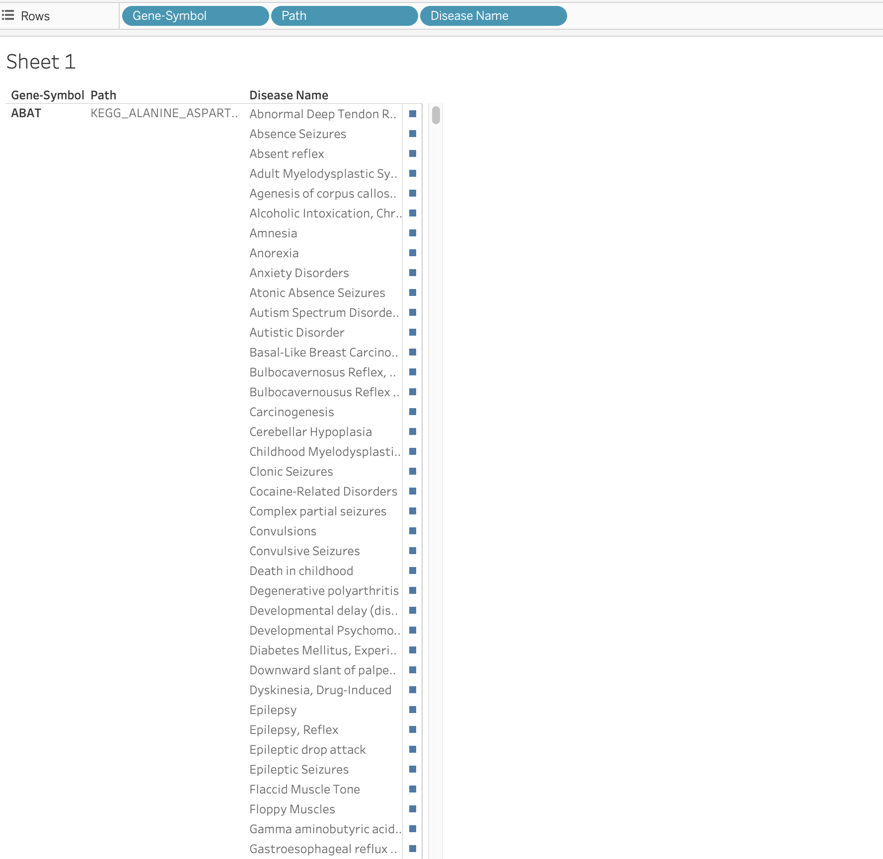
Data Tells a Story
After Panda I Love Tableau

Slide 17
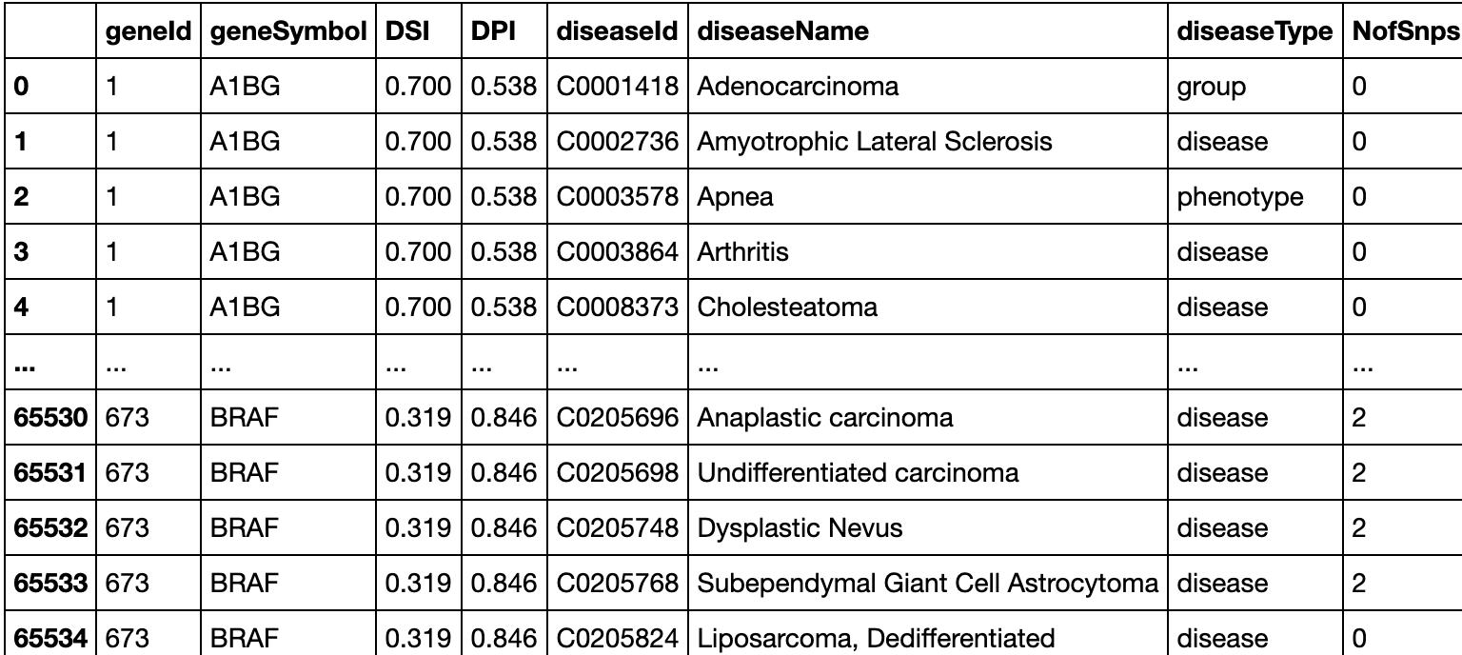
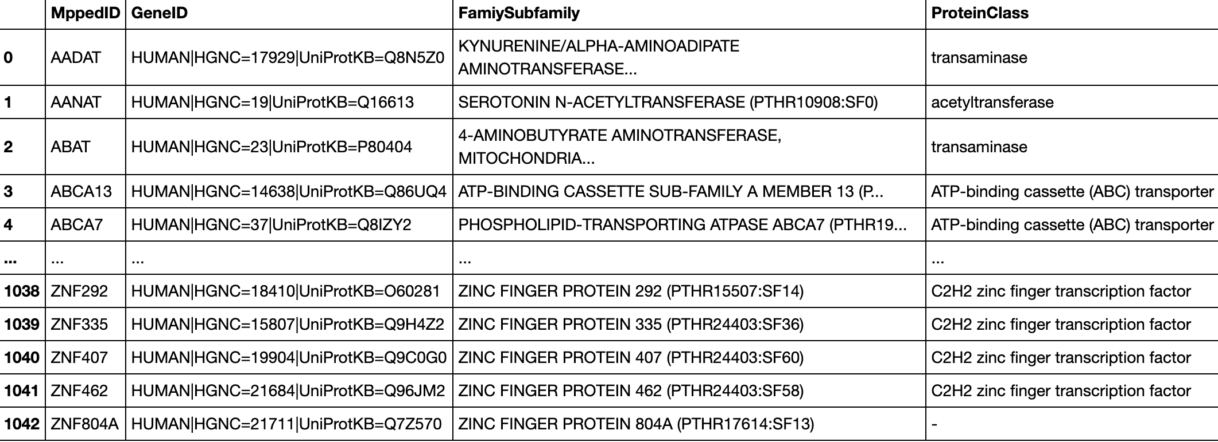
Data Tells a Story
After Panda I Love Tableau

Slide 18
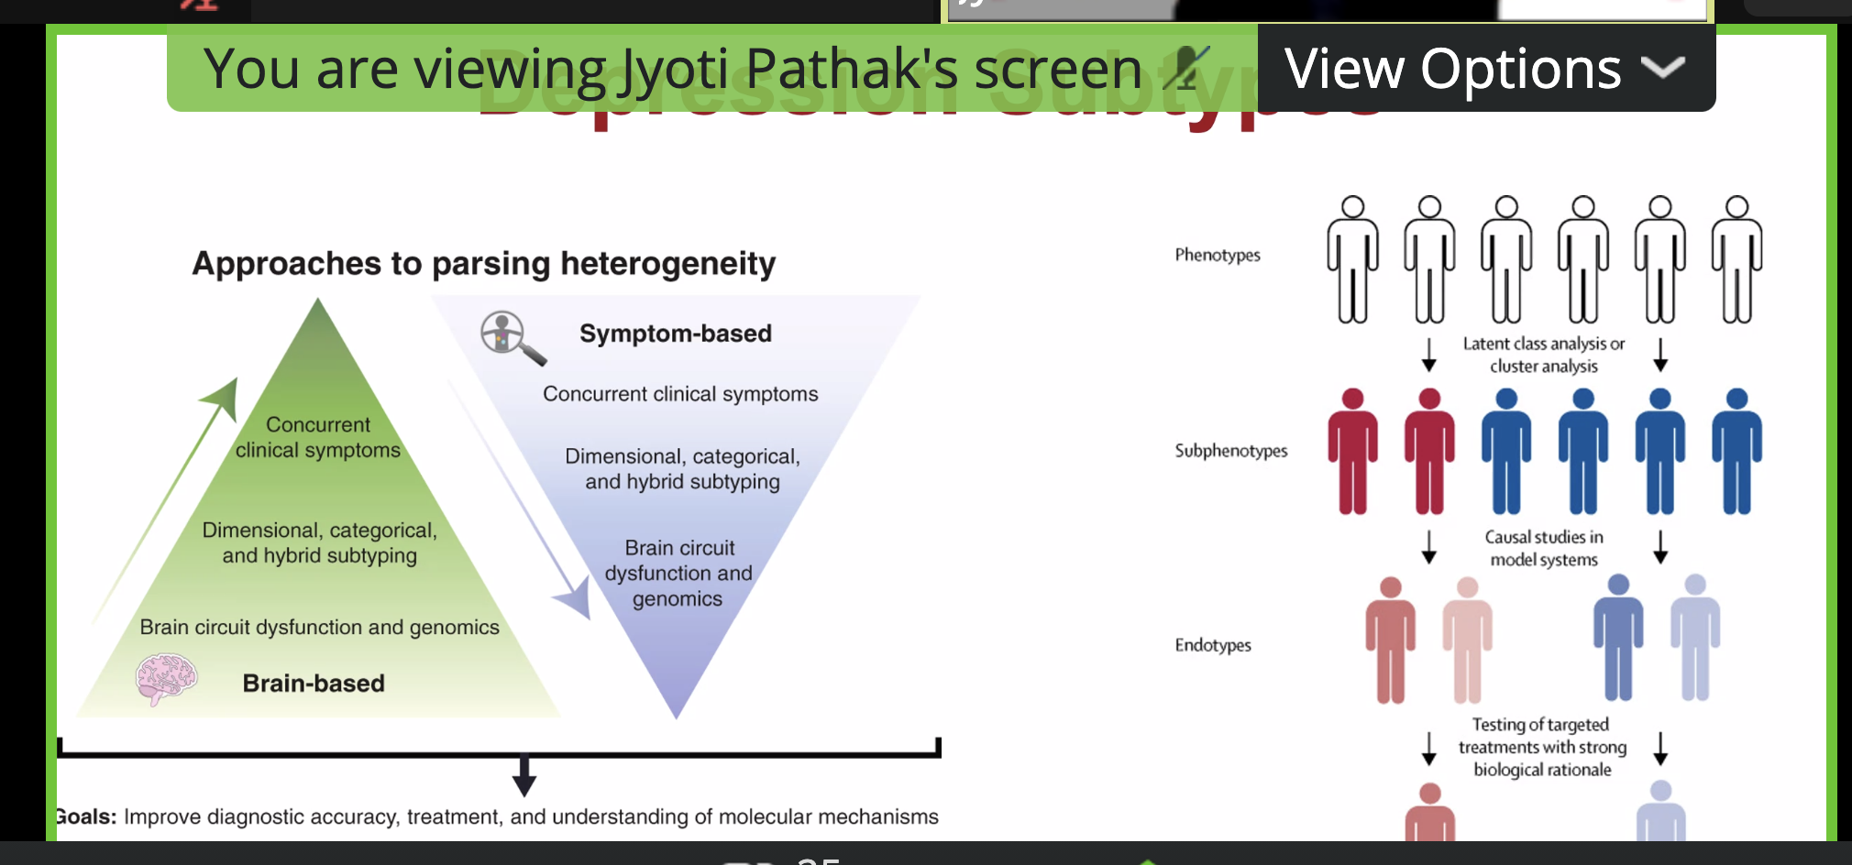
Borrowed from Grand Rounds
Brain based Personal Patient Care

Slide 19

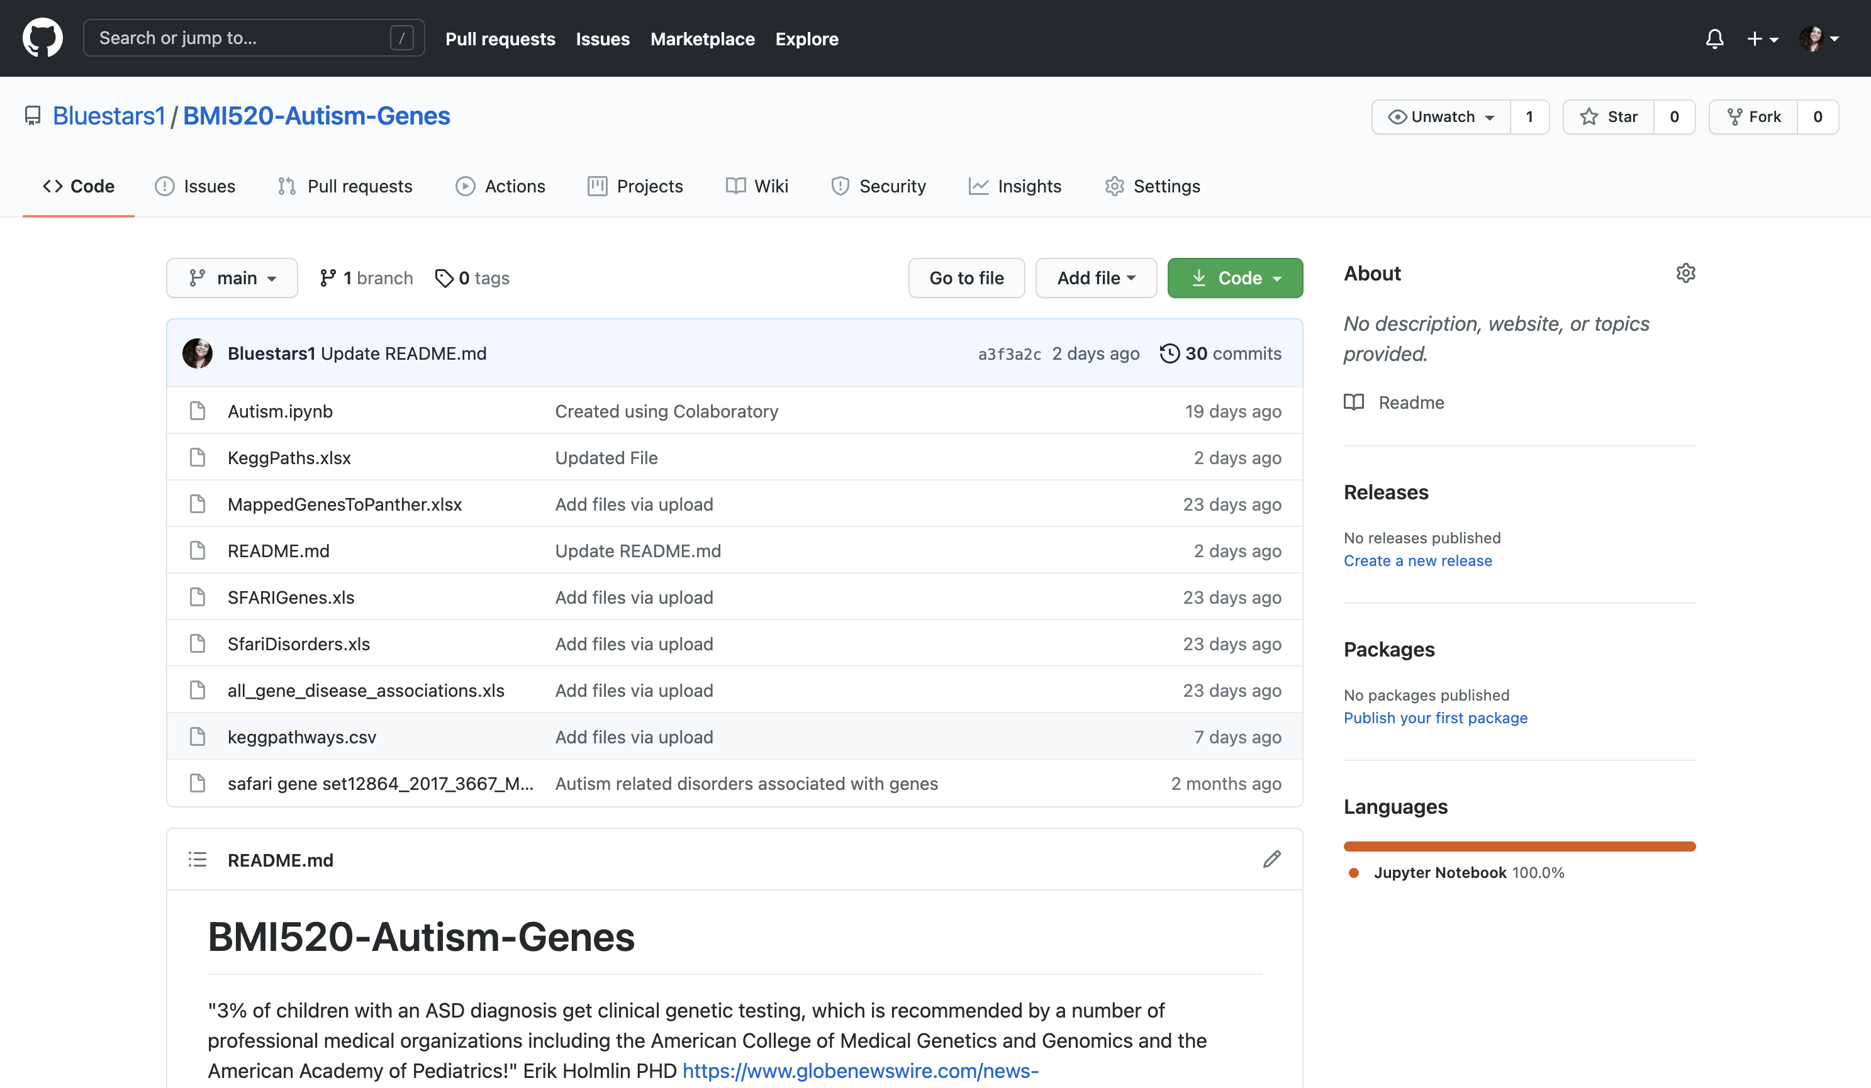
https://github.com/Bluestars1/BMI520-Autism-Genes

Slide 20
Next Steps if Time Allowed:
Analyzed Disease further to better understand the correlation
Weight Features such as Disorders 1- minimal -> 5 significant impact
Utilize Feature extraction technique to compare

Slide 21
Lessons Learned
When knowledge of toolset is limited:
Select a topic more familiar with, ensure an expert topic team member or stay with statistical rather than categorical data
BMI 520 – Eileen Keck

Slide 22

Questions

